Slide 1

Resource Certification (RPKI) @AFRINIC
Amreesh Phokeer
Research Manager
SAFNOG-5, JNB, ZA

Slide 2

Role of the RIR
Receives global allocations from IANA
Distribute and manage resources at a regional level
Make sure information are up-to-date and accurate
Becomes the de-facto authority as sole registry regionally
LACNIC
ARIN
IANA
LIR
APNIC
RIPE NCC
EU
AFRINIC

Slide 3
Resource Certificates
RPKI defines two types of certificates:
CA - Certificate Authority (to issue CA or EE)
EE - End-entity (digital signature, etc)
Certify resources - verifiable ownership!
AFRINIC has a self-signed root certificate
IANA one-day!
Opt-in service, one year validity
Exclude legacy space/members

Slide 4
Certificate hierarchy
Resource Allocation Hierarchy
Issuer: AFRINIC
Subject: ISP1
Resources: 192.2.0.0/16
Pub Key Info: <ISP1-key>
Signed by: <root-key-priv>
Issuer: ISP1
Subject: ISP2
Resources: 192.2.200.0/22
Pub Key Info: <isp2-key>
Signed by: <afrinic-key-priv>
Issuer: ISP2
Subject: ISP2-EE
Resources: 192.2.200.0/24
Pub Key Info: <isp2-ee-key>
Signed by: <isp2-key-priv>
ROA
AS 3
192.2.200.0/24-24

Slide 5
Repositories
LACNIC
R
R
ARIN
R
R
IANA
LIR
APNIC
R
Public
Certificates and ROA
CRL and MFT
Hosted or delegated
HOSTED MODE only
RIPE NCC
R
EU
AFRINIC
R
Publish at parent

Slide 6
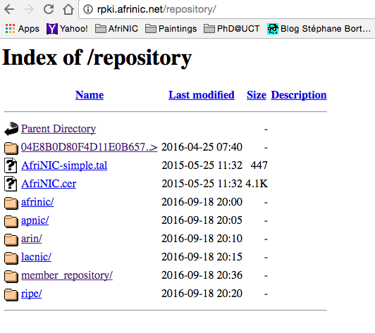
AFRINIC’s Repository
AFRINIC Root Certificate
AFRINIC member’s repository

Slide 7
Demo

Slide 8
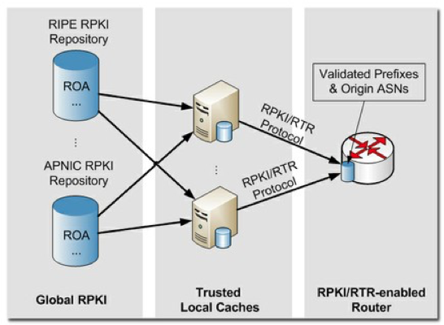
Validated caches
AFRINIC Validator Host: validator.afrinic.net Port: 8080

Slide 9
Configure your router
router bgp 12345
…
bgp rpki server tcp 192.168.179.3 port 43779 refresh 60
bgp rpki server tcp 147.28.0.84 port 93920 refresh 60

Slide 10
Route announcement status
Valid – A matching/covering prefix was found with a matching AS number
Invalid – A covering prefix was found, but the AS number did not match, and there was no other matching one
NotFound – No matching or covering prefix was found, same as today

Slide 11
You define your own policy
Fairly Secure
route-map validity-0
match rpki valid
set local-preference 100
route-map validity-1
match rpki not-found
set local-preference 50
! invalid is dropped
Paranoid
route-map validity-0
match rpki valid
set local-preference 110
! everything else dropped

Slide 12
RPKI tools
Validators:
RIPE Validator
Rcynic - www.rpki.net (CA+Validator)
RPSTIR
Routinator
Looking glasses:
bgp.he.net
RIPEStat

Slide 13
Questions
rpki-help@afrinic.net

